Slide 1
UNIT V
Storage and File Systems

Slide 2
OBJECTIVE:
Overview of Physical Storage Media
Magnetic Disks and disk storage
File Organization
Static and Dynamic Hashing

Slide 3
Overview of physical storage media
  Several types of data storage exist in most computer systems
  These storage media are classified by
    Speed with which data can be accessed
    Cost per unit of data to buy the medium
    Medium’s reliability
  volatile storage: loses contents when power is switched off
  non-volatile storage:
    Contents persist even when power is switched off.
    Includes secondary and tertiary storage, as well as batter- backed up main-memory.

Slide 4

Overview of physical storage media
Storage Hierarchy

Slide 5
Physical Storage Media
Cache – fastest and most costly form of storage; volatile; managed by the computer system hardware.
Main memory: primary storage (RAM)
  fast access
  generally too small (or too expensive) to store the entire database
  Volatile — contents of main memory are usually lost if a power failure or system crash occurs.
Flash memory
  Data survives power failure, Data can be written at a location only once, but location can be erased and written to again

Slide 6
Physical Storage Media
Magnetic-disk : Direct Access Storage Devices (secondary storage)
  Primary medium for the long-term storage of data; typically stores entire database.
  Data must be moved from disk to main memory for access, and written back for storage
  Much slower access than main memory
  direct-access – possible to read data on disk in any order, unlike magnetic tape
  Much larger capacity
  Survives power failures and system crashes
  disk failure can destroy data, but is rare

Slide 7
Physical Storage Media
Optical storage: Direct Access Storage Devices (secondary storage)
  non-volatile, data is read optically from a spinning disk using a laser
  CD-ROM (640 MB) and DVD (4.7 to 17 GB) most popular forms
  Reads and writes are slower than with magnetic disk
Tape storage Serial Devices (secondary storage)
  non-volatile, used primarily for backup (to recover from disk failure), and for archival data
  sequential-access – much slower than disk
  very high capacity (40 to 300 GB tapes available)

Slide 8
Magnetic Disks components
Provides the bulk of secondary storage for modern computer systems
Bits of data (0’s and 1’s) are stored on circular magnetic platters called disks.
Each disk platter has a flat, circular shape
Its two surfaces are covered with a magnetic material and information is recorded in the surfaces
Platter are made from rigid metal or glass
Often, several platters are organized into a disk pack (or disk drive).
Disk surface is divided into concentric tracks.
Tracks are divided into sectors
A sector is the smallest addressable unit in a disk.
Tracks under heads make a cylinder (imaginary!).
A cylinder is the set of tracks at a given radius of a disk pack.

Slide 9
Magnetic Disks operation
When the disk is in use, a drive motor spins it at a constant high speed (60,90 or 120 revolutions per second)
A disk head (read-write head) positioned just above the surface of the platter
A disk head reads and writes bits of data as they pass under the head.
The read write heads of all the tracks are mounted on a single assembly called a disk arm and move together the disk platters mounted on a spindle and the heads mounted on a disk arm are together known as head disk assemblies
Heads on all the platters move together

Slide 10
Magnetic Disks operation
Disk controllers: typically embedded in the disk drive, which acts as an interface between the CPU and the disk hardware.
The controller has an internal cache (typically a number of MBs) that it uses to buffer data for read/write requests.
When a program reads a byte from the disk, the operating system locates the surface, track and sector containing that byte, and reads the entire sector into a special area in main memory called buffer.
It accepts high level commands to read or write a sector and initiates actions such as moving the disk arm to right track and actually reading and writing the data
The bottleneck of a disk access is moving the read/write arm.
  So it makes sense to store a file in tracks that are below/above each other on different surfaces, rather than in several tracks on the same surface.
CENG 351
Notes:
22

Slide 11
Secondary storage devices :A Disk Drive
surfaces
Spindle
Boom
Read/Write heads
Disk drive with 4 platters and 8 surfaces and 8 RW heads

Slide 12
Secondary storage devices :A Disk Drive
tracks
sector
Surface of disk showing tracks and sectors
Cylinders

Slide 13
Hard Disk Layout
Head
Block
Head
motor
Platter
Sector
Track
Cylinder
Track
Drive
motor
Head, on
moving arm
Head assembly

Slide 14
Estimating Capacities
Total Track capacity = no of sectors/track * bytes/sector + no of sectors/track * interblock gap size
Useful Track capacity= no of sectors/track * bytes/sector
Cylinder capacity = no of tracks/cylinder * track capacity
Drive capacity = no of cylinders * cylinder capacity
Number of cylinders = no of tracks in a surface

Slide 15
Exercise
Store a file of 20000 records on a disk with the following characteristics:
  # of bytes per sector = 512
  # of sectors per track = 40
  # of tracks per cylinder = 11
  # of cylinders = 1331
Q1. How many cylinders does the file require if each data record requires 256 bytes?
Q2. What is the total capacity of the disk?

Slide 16
solution
Q. 1 Total memory size= 20000*256 =5120000 bytes
5120000/512 (bytes/sector) =10000 sectors required
10000/40 (sector/track) = 250 tracks required
250/ 11 (no of tracks/cylinder) = 22.72 = 23 cylinders required
Q. 2 Useful Track capacity= no of sectors/track * bytes/sector
= 40 * 512 = 20480 bytes
Cylinder capacity = no of tracks/cylinder * track capacity
= 11 * 20480 = 225280 bytes
Drive capacity = no of cylinders * cylinder capacity
= 225280 *1331 = 299847680 bytes = 300 mb

Slide 17
File organization
File organization refers to the organization of data of a file into records, blocks and access structures
This includes the way of records and blocks are placed on the storage medium and interlinked
It is the methodology which is applied to structured computer files.
An access method provides a group of operations that can be applied to a file.
Some access methods, can be applied only to files organized in certain ways

Slide 18
File Organization
Organizing a file depends on what kind of file it happens to be: a file in the simplest form can be a text file,
Files can also be created as binary or executable types
Some files may be static- update operations are rarely preformed
Dynamic files may change frequently

Slide 19
Techniques of File Organization
The techniques of primary file organization are:
Heap files (unordered)
Sorted files (Ordered)
Hashed or Direct files
Additional auxiliary access structures called indexes which are used to speed up the retrieval of records in response to certain search conditions

Slide 20
Heap files (Unordered Records)
Records are placed in the files in the order in which they are inserted
So new records are inserted at the end of the file
Such organization is called heap file
It is the simplest and most basic type of organization
It is also used to collect and store data records for future use
Though inserting a new record is very efficient, searching for a record (linear search) is an expensive procedure

Slide 21
Heap files (Unordered Records)
While inserting a new record, the last block of the file is copied into a buffer, the new record is added and the block is then rewritten back to disk
The address of the last file block is kept in the file header
To delete a record, a program must first find its block, copy the block into a buffer, delete the record from the buffer and finally rewrite the block back to the disk
This leaves unused space in the disk block

Slide 22
Heap files (Unordered Records)
Deleting a large number of records in this way results in wasted storage space
So another technique used for record deletion with a deletion marker stored with each record
To read all records, we create a sorted copy of the file.
Sorting is an expensive operation for a large disk file

Slide 23
Sorted files (Ordered Records)
We can physically order the records of a file on disk based on their ordering field
Reading the records from a file is extremely efficient because no sorting is required
Finding the next record from the current one usually requires no additional block access as next record is in the same block as the current block
Using a search condition results in faster access when binary search technique is used

Slide 24
Sorted files (Ordered Records)
Inserting and deleting records are expensive operations for an ordered file because the records must remain physically ordered
To insert a new record, we must find its correct position in the file and then make space in the file to insert the record in that position
For a large file this can be very time consuming
For a deletion, the problem is less severe if deletion marker and periodic reorganization are used
Ordered files are rarely used in database applications

Slide 25
Hashing Techniques
Hashing is a primary file organization which provides very fast access to records under certain search conditions
This organization is usually called a hash file
The search condition must be an equality condition on a single field called hash field
Hashing provide a function h, called hash function which is applied to hash field and yields the address of the disk block in which the record is stored

Slide 26
Hashing Techniques
A search for the record within the block can be carried out in a main memory buffer
For most records, a single block access is needed to retrieve that record
Hashing is also used as an internal search structure within a program whenever a group of records is accessed exclusively

Slide 27
Internal hashing
For internal files, Hashing is implemented as a hash table through the use of an array of records
The array index range is from 0 to M-1
Then we have m slots whose address corresponds to array index
A hash function transforms a hash field value into an integer between 0 to M-1
A common hash function H(k)=k mod M returns the remainder of an integer hash field K which is used for the record address

Slide 28
Internal hashing
A collision occurs when the hash field value of a record that is being inserted hashes an address that already contains a different record
In this situation, we must insert the new record in some other position, since its hash address is occupied
The process of finding another position is called collision resolution
A goal a good hashing function is to distribute the records uniformly over the address space so as to minimize collision while not leaving many unused locations

Slide 29
External hashing
Hashing for disk files is called external hashing
The target address space is made of buckets, each of which holds multiple records
A bucket in a hash file is unit of storage (typically a disk block) that can hold one or more records.
A bucket is either one disk block or clusters of contiguous blocks

Slide 30
Static Hashing (external hashing)
The hash function, maps a key into a relative bucket number rather than assigning an absolute block address to the bucket
A table maintained in the file header converts the bucket number into the corresponding disk block address as shown in diagram
This hashing scheme is called static hashing because a fixed number of buckets M is allocated

Slide 31
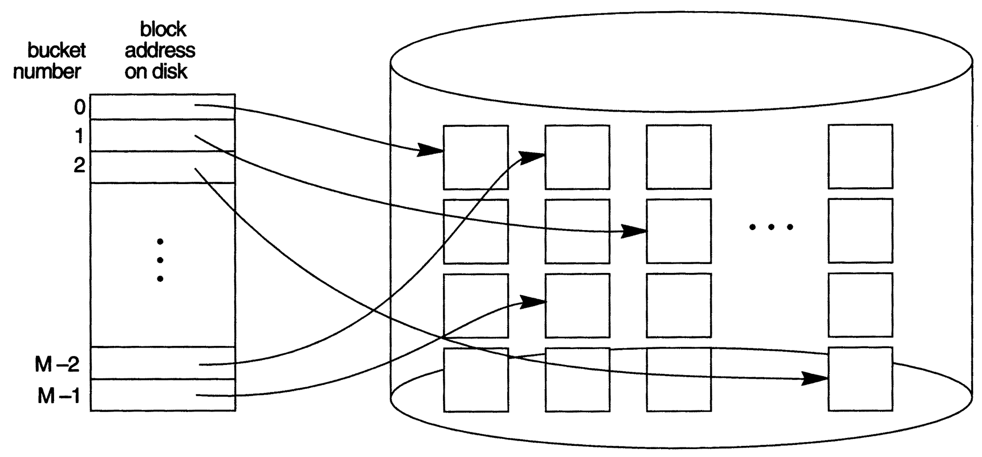
Static Hashing (external hashing)
Matching bucket numbers to disk block addresses

Slide 32
Static Hashing (external hashing)
It has a serious drawback for dynamic files
Suppose there are M buckets for the address space and let m be the maximum number of records that can fit in one bucket
Then at the most (M*m)records will fit in the allocated space
If number of records are substantially fewer, then left a lot of unused space
And if number of records increases, collisions will result and retrieval will be slowed down

Slide 33
Dynamic Hashing
More effective than static hashing when the database grows or shrinks
Extendible hashing splits and combine buckets appropriately with the database size.
  i.e. buckets are added and deleted on demand.
Stores an access structure in addition to file
Access structure is based on the values that result after application of the hash function to the search field

Slide 34
Dynamic Hashing: Advantages & Disadvantages
Performance of the file does not degrade as the file grows as opposed to static
no space is allocated in extendible hashing for future growth but additional buckets can be allocated dynamically as needed
The space overhead for directory table is negligible
Splitting causes minor reorganization in most cases
The directory must be searched before accessing the buckets themselves

